Slide 1
Interactive 3D Solar System Project

Slide 2
Interactive 3D Solar System Project
Interactive 3D Solar System Orrery
Problem Statement
Project Objective
Key Features
Demonstration
Impact and Relevance
Conclusion

Slide 3
Interactive 3D Solar System Orrery
Project Title: The title 'Interactive 3D Solar System Orrery' emphasizes innovative educational visualization techniques in astronomy.
Team Name: Spaceshuttler
Team Lead: Satyayu Neupane

Slide 4
Problem Statement
Traditional Understanding Hurdles: Conventional methods often employ static diagrams, failing to convey dynamic celestial relationships effectively.
Engagement Deficiency: Learners struggle with passive learning approaches, which diminish curiosity and hinder a proactive exploration of astronomy.
Interactive Tool Necessity: An interactive interface facilitates real-time manipulation of planetary models, enhancing comprehension and retention of concepts.

Slide 5
Project Objective
Enhancing Educational Engagement: Creating an interactive model captivates learners' interest, fostering deeper connections to astronomical concepts and phenomena.
Broadening Accessibility: Interactive tools democratize astronomy education, allowing diverse audiences of all ages to explore complex ideas effortlessly.
Supporting Active Learning: Facilitating exploration through 3D visualization encourages critical thinking and problem-solving skills within educational contexts.

Slide 6
Key Features
3D Visualization: Utilizing advanced 3D graphics for a lifelike representation enhances spatial understanding of celestial bodies.
Realistic Planet Textures: Authentic textures provide an immersive experience, allowing users to appreciate the distinctive surfaces of planets.
Customizable User Interaction: Users can customize views and interact by clicking on planets, promoting personalized learning experiences.

Slide 7
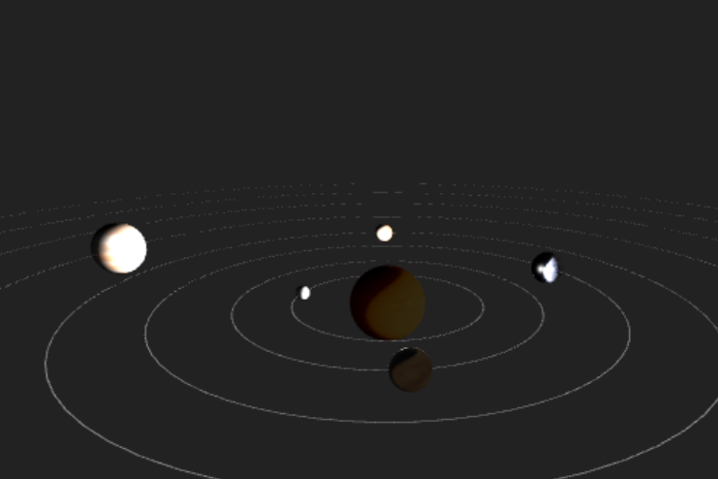
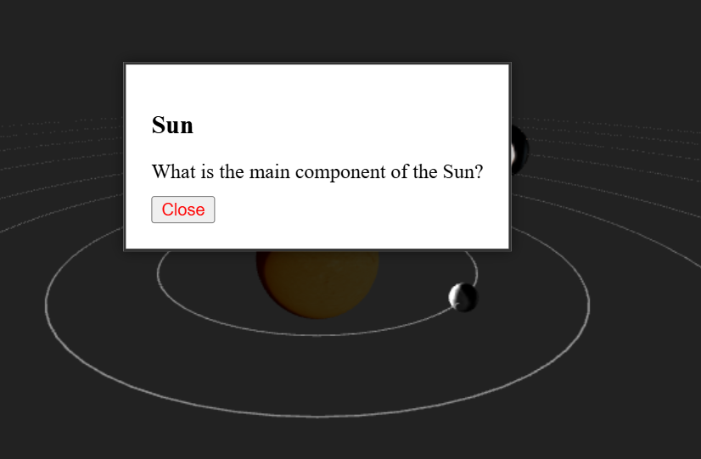
Demonstration
Orrery Interface Overview: The interface simplifies navigation through the solar system, offering intuitive tools for exploration and learning.
Planet Texture Close-Up: Incorporating high-resolution imagery reveals intricate details of each planet's surface, enhancing user engagement and curiosity.
Interactive Quiz Popup: Clicking on planets initiates interactive quizzes, reinforcing knowledge retention and promoting active participation in learning.

Slide 8
Impact and Relevance
Beneficiary Demographics: Students, educators, and astronomy enthusiasts gain interactive educational benefits from the 3D orrery project.
Alignment with Standards: The project adheres to contemporary educational standards emphasizing engagement, interaction, and experiential learning methodologies.
Lifelong Learning Enhancement: Interactive tools empower users of all ages to pursue lifelong learning in an enjoyable educational environment.

Slide 9
Conclusion
Engagement Enhancement: The project significantly improves learner engagement, transforming astronomy education into an immersive and interactive experience.
Understanding Improvement: Through 3D visualization, learners gain depth in understanding, visualizing complex astronomical relationships with ease.
Thank You!: We appreciate your attention and hope this presentation ignites curiosity about the universe and learning!

